Slide 1
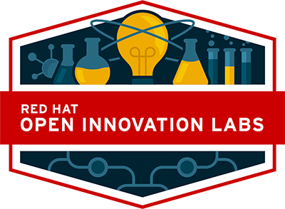

DevOps Culture and Practice Enablement
Exercise 1 - Introduction

Slide 2


Topics
Lab Setup and Access
How to setup your account and access CodeReady Workspaces and the OpenShift Environment
Codeready Workspaces
Accessing and understanding CodeReady Workspaces
Technical Exercise Introduction
Introduction to the technical exercise and what is to be accomplished
Technical Hands-On Exercises
Jenkins
Nexus
Gitlab
Ansible
Eclipse Che (CodeReady Workspace)
OpenShift Applier
Notes:
Briefly introduce the topics contained within this page

Slide 3
Lab Setup
&
Access
NORTH AMERICA - November 2019 All-Hands Call
Notes:
Accessing Student VMs through Workstation Port Forwarding
Accessing Student VMs through Bastion Port Forwarding

Slide 4
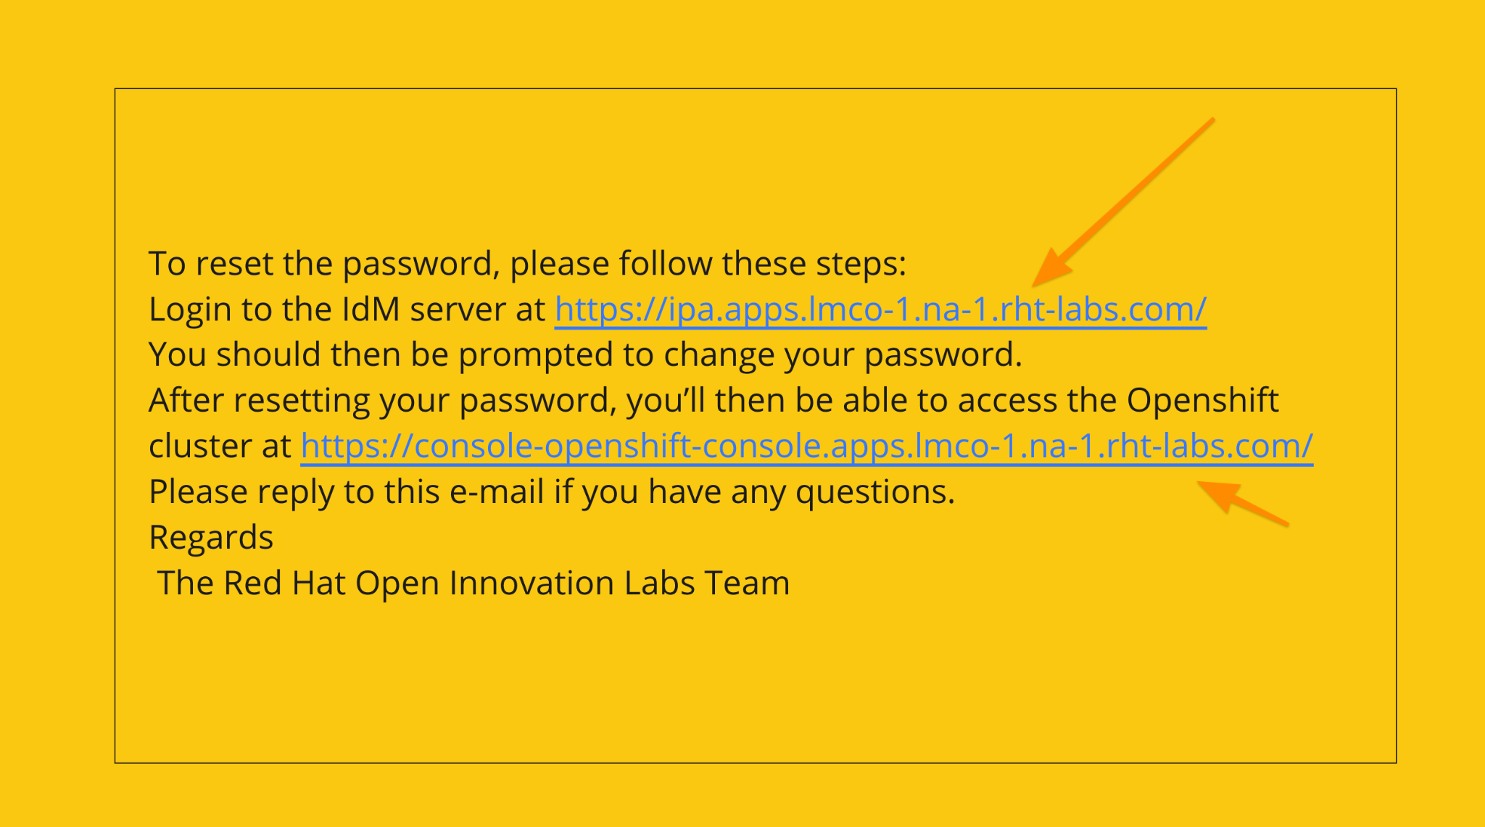
User Account Setup

Slide 5
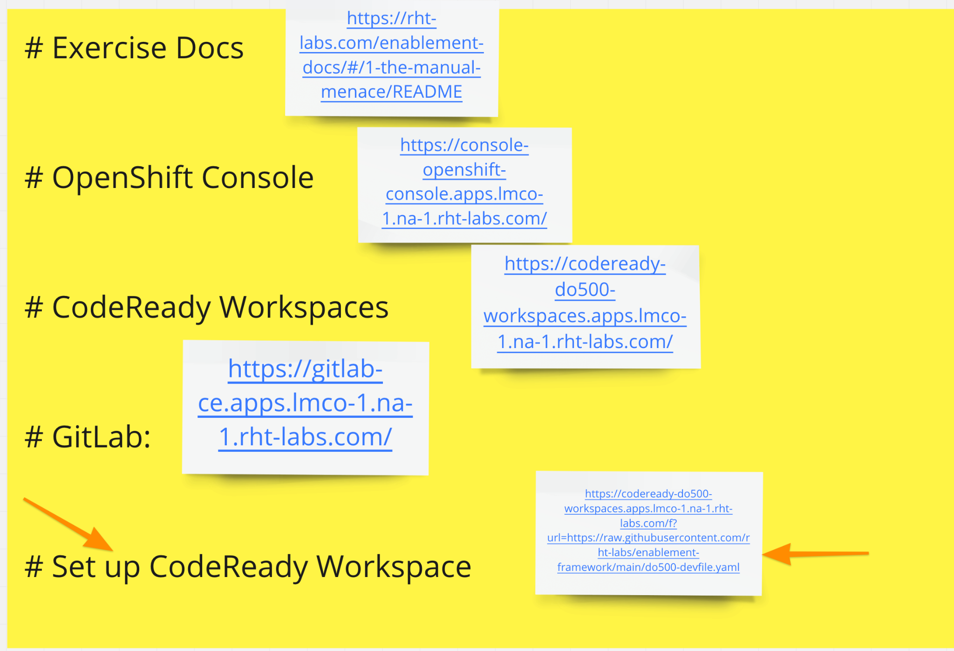
CodeReady Workspace Setup

Slide 6
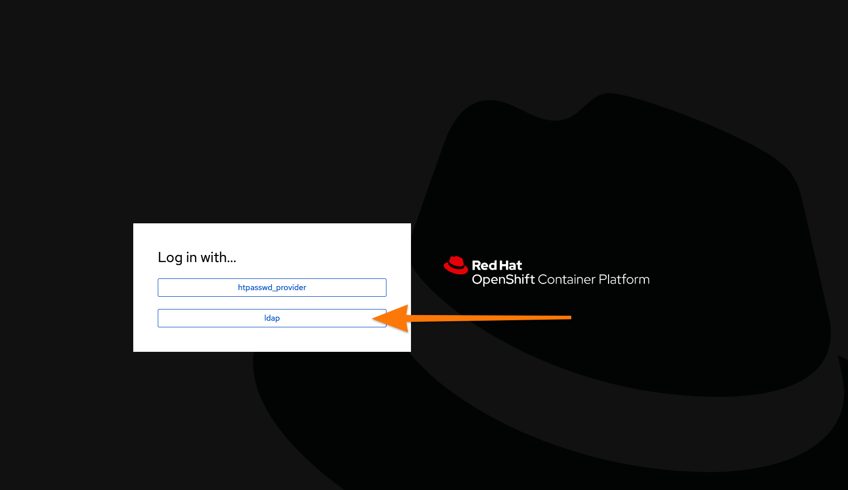
CodeReady Workspace Setup

Slide 7
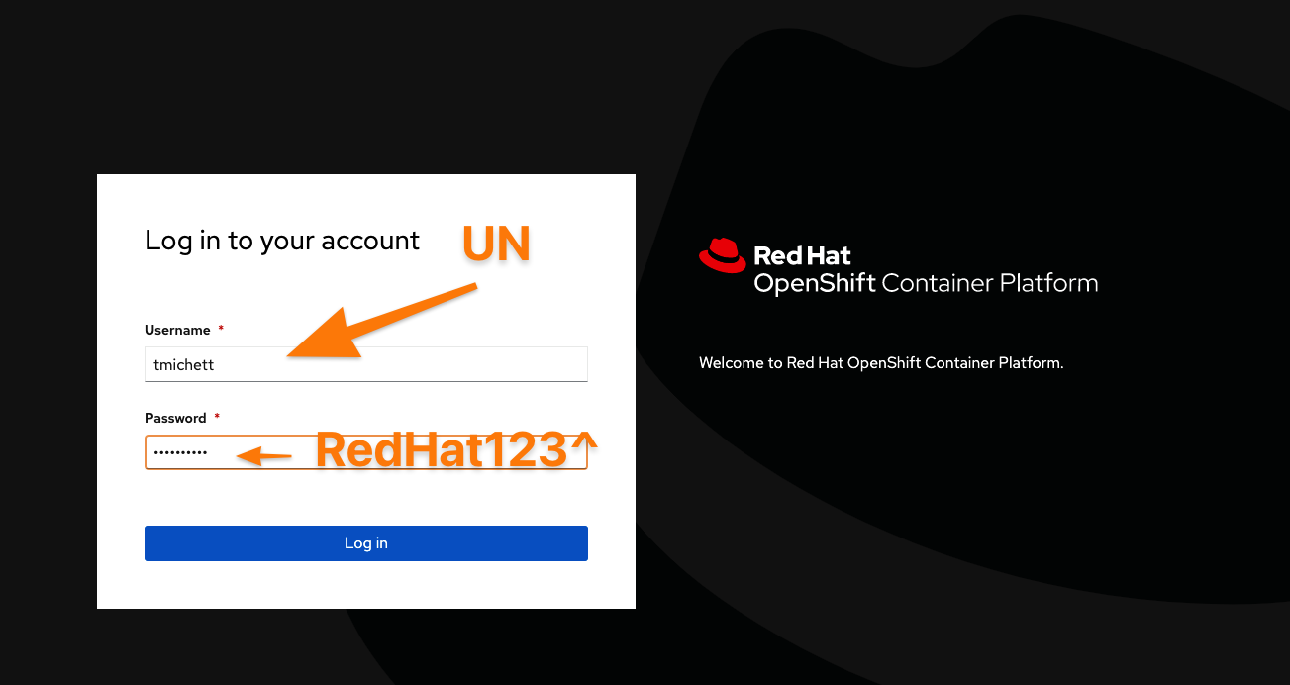
CodeReady Workspace Setup Cont.

Slide 8
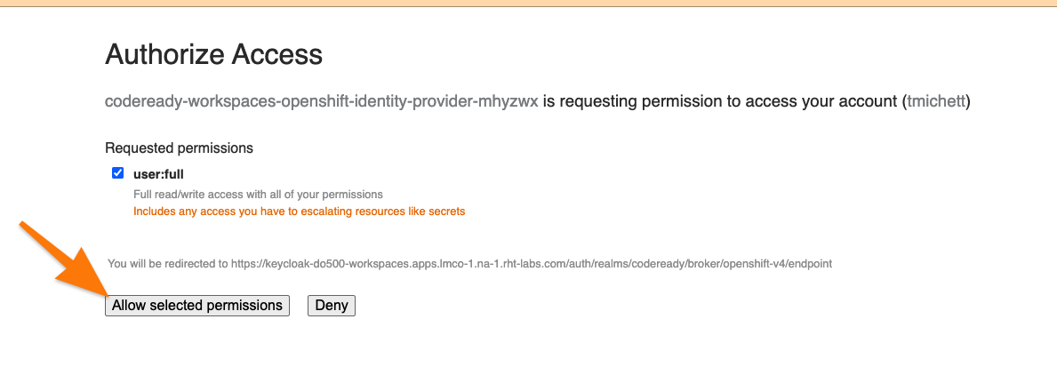
CodeReady Workspace Setup Cont.

Slide 9
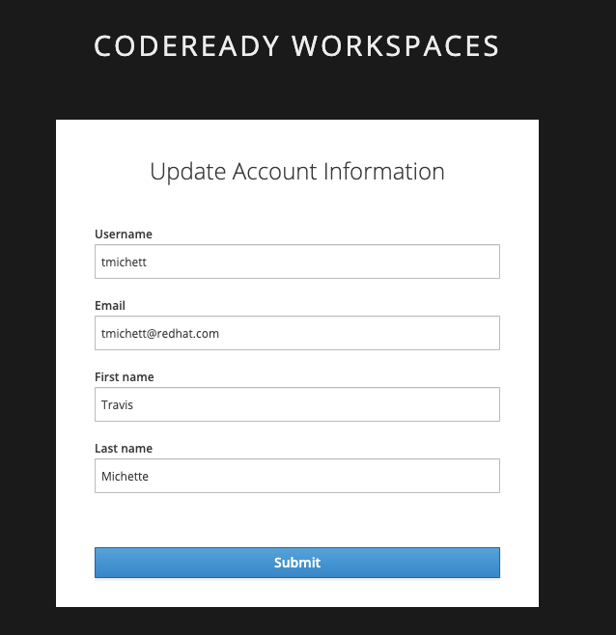
CodeReady Workspace Setup Cont.

Slide 10
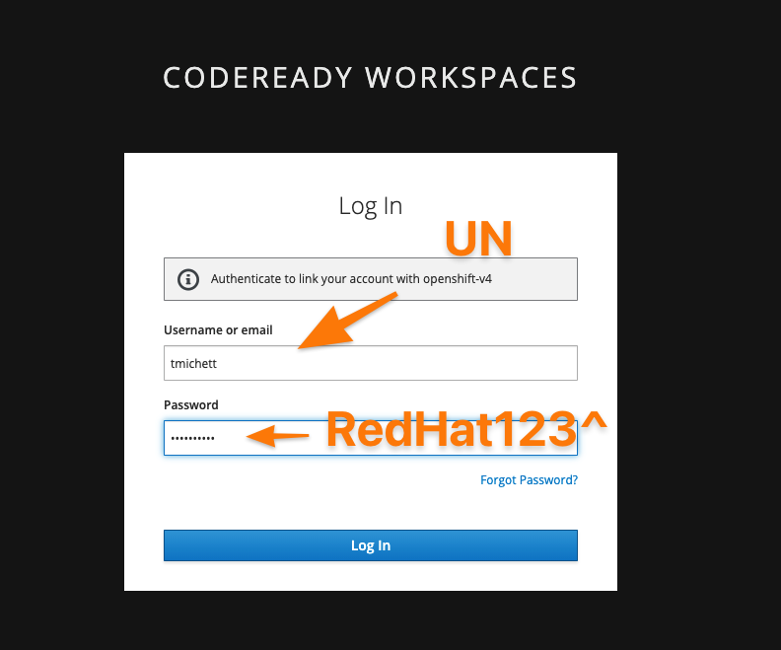
CodeReady Workspace Setup Cont.

Slide 11
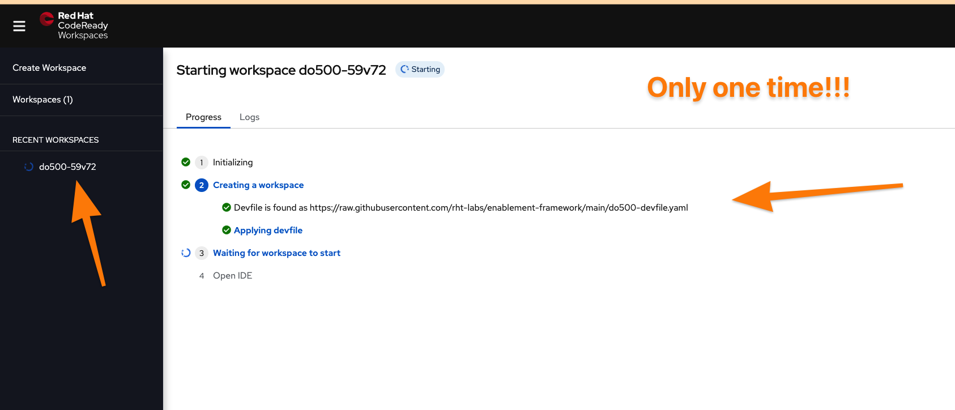
CodeReady Workspace Setup Cont.

Slide 12
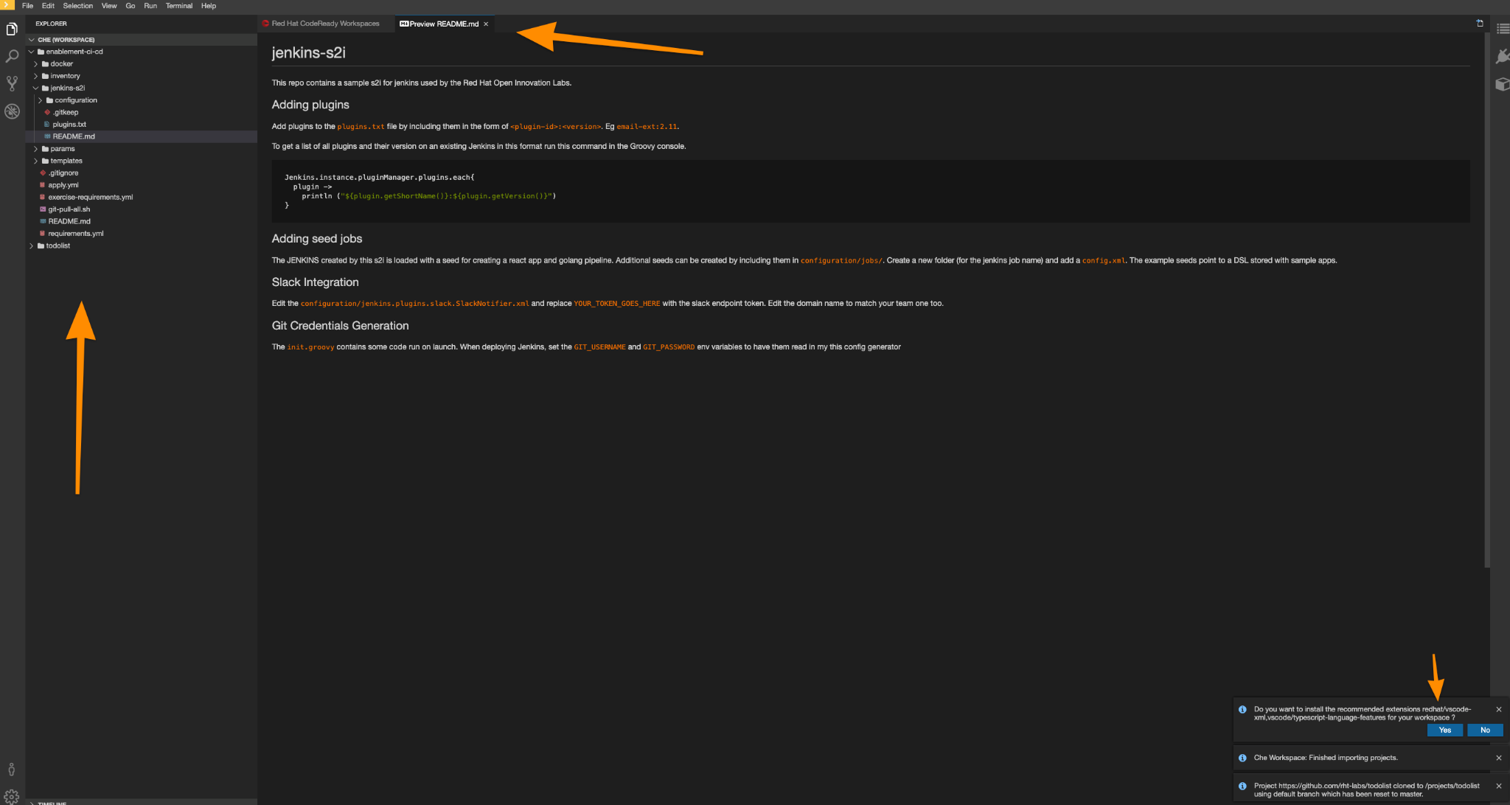
CodeReady Workspace Setup Completed

Slide 13
CodeReady
Workspace
Introduction
NORTH AMERICA - November 2019 All-Hands Call
Notes:
Instructor ToolKit
MOJO - New Site
RHLC
Knowledge management
RHU ROL / public ROL

Slide 14
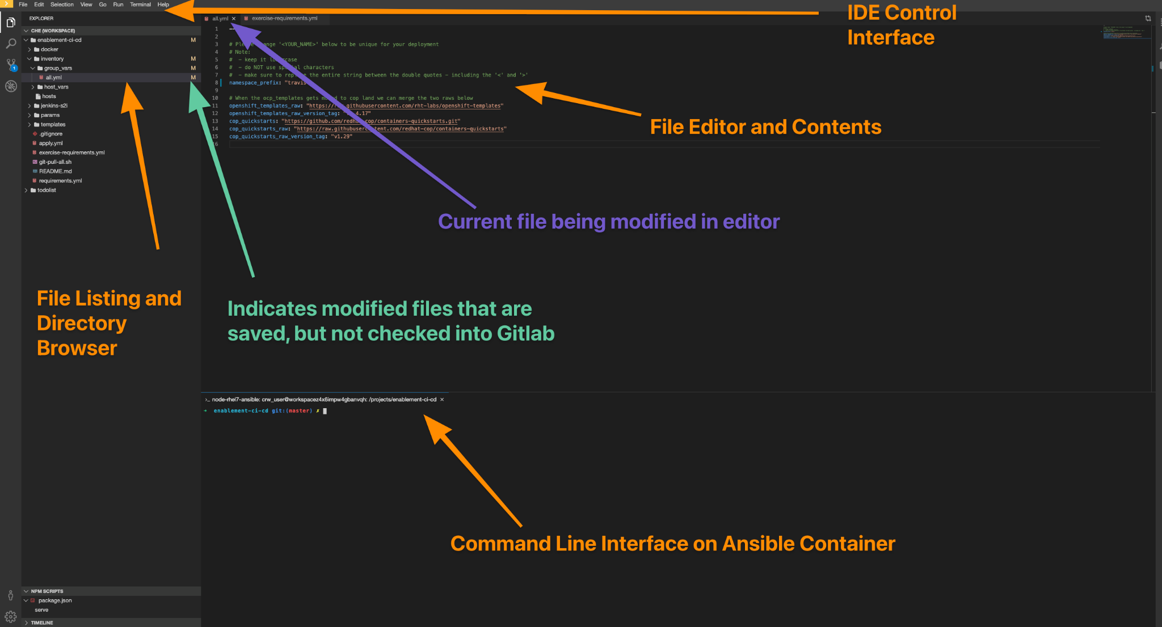
CodeReady Workspace Overview

Slide 15
Technical Exercise Introduction
NORTH AMERICA - November 2019 All-Hands Call

Slide 16
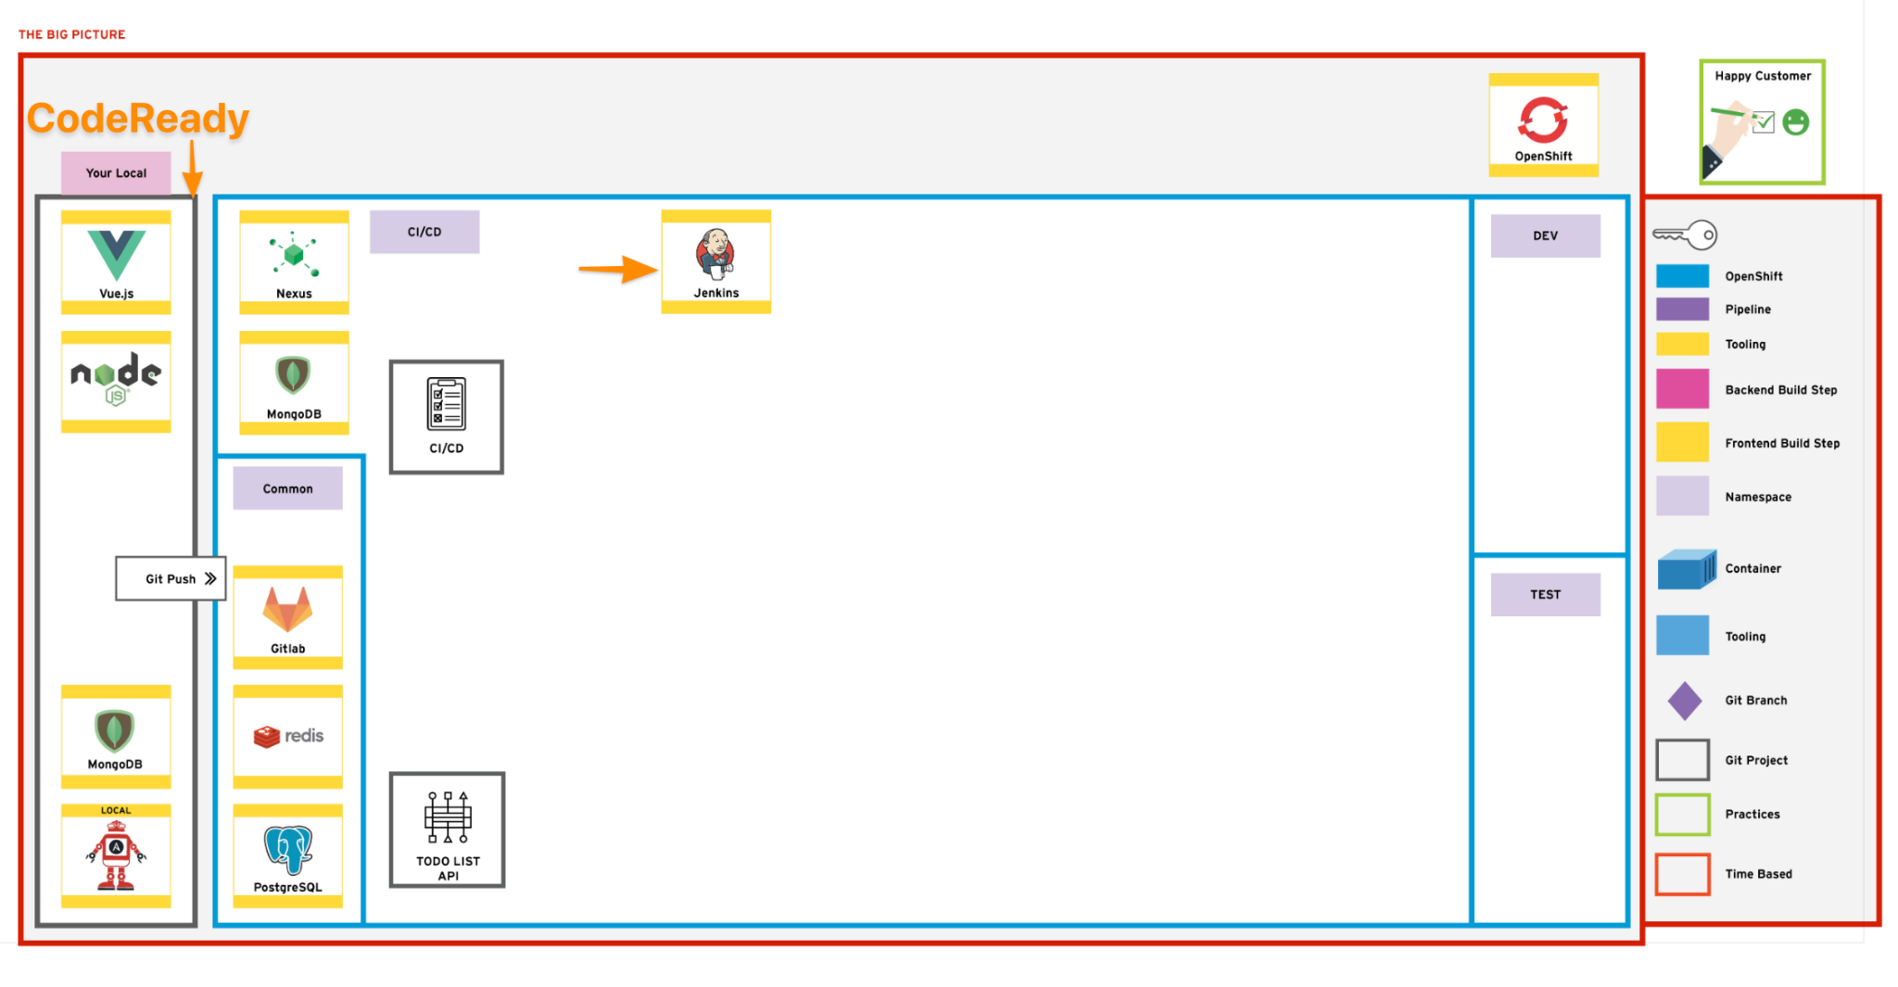
The Big Picture

Slide 17
Exercise Objectives
Setup CodeReady Workspace and OpenShift environment including user accounts
Access CodeReady/Che Workspace for hands-on technical exercises
Create initial automation environment with Configuration-as-Code
Building initial foundation tooling to facilitate deployment and lifecycle management of a custom application which can be automated
Create Project Namespaces for:
CI/CD Tooling
Development Environment
Test Environment
Create an Infrastructure-as-Code environment for a sample DevOps deployment

Slide 18
Tools and Frameworks Used
Openshift Container Platform - Red Hat's private, on-premise cloud application deployment and hosting platform
GitLab - Community driven Git server now with integrated DevOps Toolchain.
Nexus - Repository manager for storing lots of application types. Can also host npm and Docker registries.
Jenkins - OpenSource Build automation server. Highly customisable with plugins.
Ansible - IT Automation tool used to provision and manage state of cloud and physical infrastructure.
openshift-applier - used to apply OpenShift objects to an OpenShift Cluster.

Slide 19
Exercise Steps (10,000’ View)
Clone the repo https://github.com/rht-labs/enablement-ci-cd which contains the scaffold of the project. (Already completed for you as part of CodeReady Workspace)
Create <your-name>-ci-cd, <your-name>-dev and <your-name>-test project namespaces using the inventory and run them with the OpenShift Applier to populate the cluster.
Use the templates provided to create build and deployment configs in <your-name>-ci-cd project to be leveraged throughout the rest of the guided exercises.
Nexus
GitLab
Jenkins (using an s2i to pre-configure jenkins)
Commit your enablement-ci-cd repository to the GitLab Instance you've created.
Burn it all down and re-apply your inventory proving config-as-code works.

Slide 20

Exercise 1 - Introduction Crawl

Slide 21
Technical
Hands-on
Exercises
NORTH AMERICA - November 2019 All-Hands Call

Slide 22
What is this exercise about?
This exercise is all about automation and configuration-as-code.
This exercise is aimed at the creation of the supporting tooling that will be used to support the rest of the exercises using code.
The high level goal is to create a collection of project namespaces and populate them with Git, Jenkins & Nexus using code.
As a learner, you will be able to:
Run the openshift-applier to automate creating cluster content
Create and admin project namespaces in OpenShift
Deploy commonly used applications to support the development process

Slide 23
Why is automation important and how does it help?
Assurance - Prevents unwanted config changes from people making arbitrary changes to environments. No more Snowflake servers!
Traceability - Commiting configuration-as-code means a user has approved and changes can be tracked.
Phoenix Server - Burn it all to the ground and bring it back; exactly the way it was!

Slide 24
Technical Hands-On Exercises
Hands-On Activities
Infrastructure-as-Code (Gitlab)
Pipelines (Jenkins)
Containers and Orchestration (OpenShift)
Container Registries (Nexus)
Automation (Ansible)
Local development environment (CodeReady Workspace)
… and more

Slide 25
Thank you
Red Hat is the world’s leading provider of enterprise open source software solutions. Award-winning support, training, and consulting services make Red Hat a trusted adviser to the Fortune 500.
E-Mail: tmichett@redhat.com

